Slide 1
Friend Function and Friend Class

Slide 2
Friend Function
The concepts of encapsulation and data hiding dictate that non-member functions should not be able to access an object’s private or protected data.
However, there are situations where such rigid discrimination leads to considerable inconvenience.

Slide 3
Friend Function
A friend function is a function that can access the non-public members of a class, even though the function itself is not a member of the class.
A friend function is a normal function with special access privileges.

Slide 4
Friend Function
A friend function of a class is a non-member function of a class that has the right to access all private and protected (non-public) members of the class.
Friend function prototype should be placed inside the class definition (can be any where inside the class definition).
Friend function definition should be outside the class scope.
Even though the prototypes of friend functions appear in the class definition, friends are not member functions.

Slide 5
A friend function of a class can be a
function (non-member of a class)
member function of another class
function template
To declare a function as a friend of a class, precede the function prototype in the class definition with keyword friend.
Friend functions are used in Operator overloading to increase the versatility of operators.

Slide 6
General Syntax
class ClassName {
...... .... ........
friend returnType functionName( arguments ); // friend function declaration
...... .... ........
};
// friend function definition does not start with friend keyword
returnType functionName( arguments ) {
…. …. ….
// private and protected data of the above class can be accessed from this function
…. …. …. }
int main( ) { ….
functionName( arguments ); // Call to the friend function
…..}

Slide 7
Sample Program 1

Slide 8
Difference between Friend function and Member function
Member Function | Friend Function
It is invoked through an object | Not invoked through an object since it is a non-member of a class If the friend function of class X is a member function of class Y, then it must be invoked through an object of class Y
Can access the non-public members of the class directly | Can access the non-public members of the class only through an object (since this pointer is not visible)

Slide 9
Sample Program 2

Slide 11
Sample Program 3

Slide 14
Friends to more than One Class Act as Bridges
Imagine that you want a function to operate on objects of two different classes.
Perhaps the function will take objects of the two classes as arguments, and operate on their private data. Here’s a simple example, that shows how friend functions can act as a bridge between two classes.

Slide 17
Friend Class
//function of another class
// as a friend function
#include <iostream>
using namespace std;
class base;
// forward definition needed
// another class in
//which function is declared
class anotherClass {
public:
void memberFunction(base& obj);
};
// base class for which friend is declared
class base {
private:
int private_variable;
protected:
int protected_variable;
public:
base()
{
private_variable = 10;
protected_variable = 99;
}
// friend function declaration
friend void anotherClass::memberFunction(base&);
};

Slide 18
// friend function definition
void anotherClass::memberFunction(base& obj)
{
cout << "Private Variable: " << obj.private_variable
<< endl;
cout << "Protected Variable: " << obj.protected_variable;
}
// driver code
int main()
{
base object1;
anotherClass object2;
object2.memberFunction(object1);
return 0;
}

Slide 19
Breaching the Walls
Friend function violates the concepts of data hiding, the philosophy that only member functions can access a class’s private data.
How serious is the breach of data integrity when friend functions are used?
A friend function must be declared as such within the class whose data it will access. Thus a programmer who does not have access to the source code for the class cannot make a function into a friend.
In this respect, the integrity of the class is still protected.
Friend functions are conceptually messy, and potentially lead to a spaghetti-code situation if numerous friends muddy the clear boundaries between classes.
For this reason friend functions should be used sparingly. If you find yourself using many friends, you may need to rethink the design of the program.

Slide 20
Railway Reservation

Slide 21
CASE STUDY - RRS
Develop a function to calculate total fare for a ticket. There are ‘n’ passengers in the ticket and they are from a family of a railway employee. Discount is given for their travel based on the cader of the employee.

Slide 22
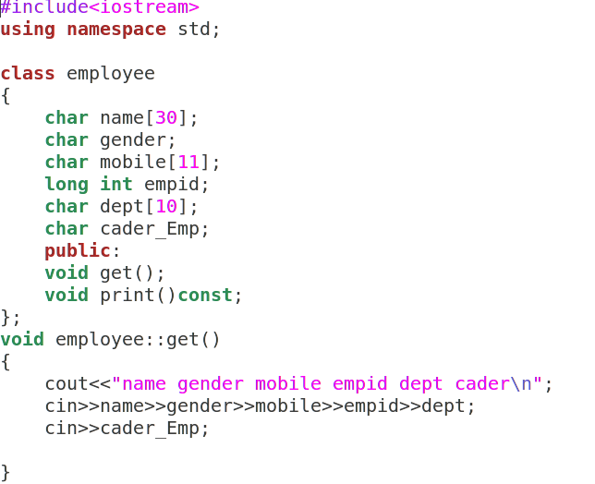

Slide 23
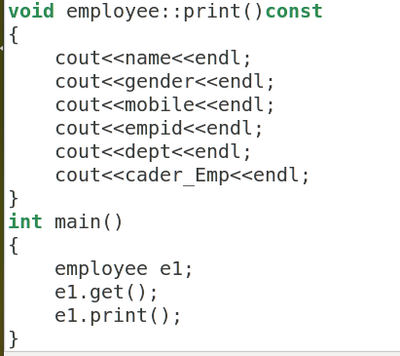

Slide 24
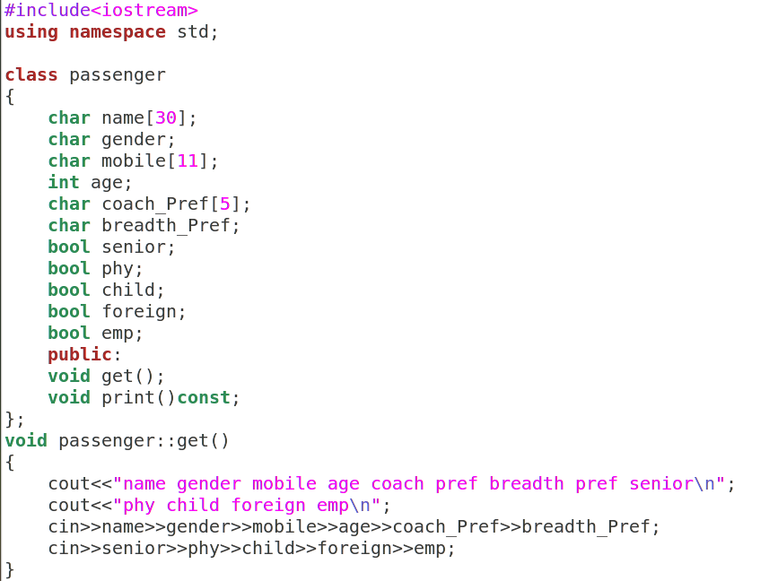

Slide 25
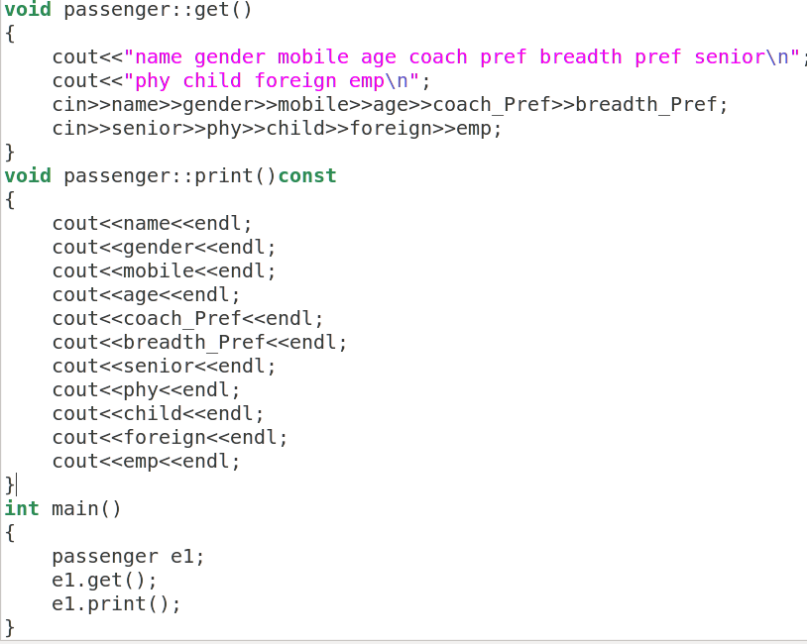

Slide 26
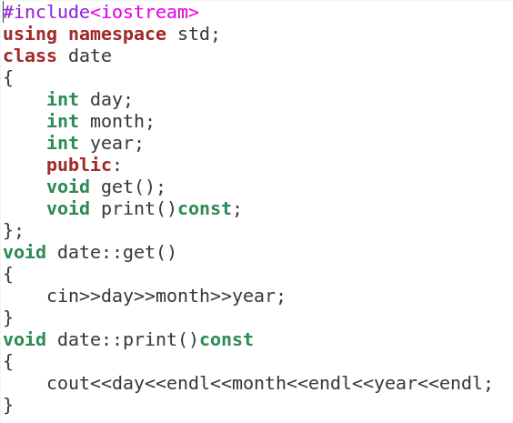

Slide 27
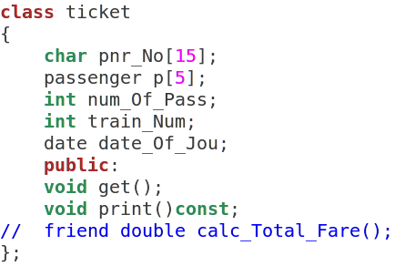

Slide 28
